Slide 1
Chapter 2: Operating-System Structures

Slide 2
Chapter 2: Operating-System Structures
Operating System Services
User Operating System Interface
System Calls
Types of System Calls
System Programs
Operating System Design and Implementation
Operating System Structure
Virtual Machines
Operating System Generation
System Boot

Slide 3
Objectives
To describe the services an operating system provides to users, processes, and other systems
To discuss the various ways of structuring an operating system
To explain how operating systems are installed and customized and how they boot

Slide 4
2.1 Operating System Services
Operating System services
  For system itself
  For users
Two interfaces to those services for users
  Command interface
    Command-Line (CLI)
    Graphics User Interface (GUI)
    Batch
  Programming interface
    System calls
    API

Slide 5
Operating System Services
One set of operating-system services provides functions that are helpful to the user:
  User interface - Almost all operating systems have a user interface (UI)
    Varies between Command-Line (CLI), Graphics User Interface (GUI), Batch
  Program execution - The system must be able to load a program into memory and to run that program, end execution, either normally or abnormally (indicating error)
  I/O operations - A running program may require I/O, which may involve a file or an I/O device.
  File-system manipulation - The file system is of particular interest. Obviously, programs need to read and write files and directories, create and delete them, search them, list file Information, permission management.

Slide 6
Operating System Services (Cont.)
One set of operating-system services provides functions that are helpful to the user (Cont):
  Communications – Processes may exchange information, on the same computer or between computers over a network
    Communications may be via shared memory or through message passing (packets moved by the OS)
  Error detection – OS needs to be constantly aware of possible errors
    May occur in the CPU and memory hardware, in I/O devices, in user program
    For each type of error, OS should take the appropriate action to ensure correct and consistent computing
    Debugging facilities can greatly enhance the user’s and programmer’s abilities to efficiently use the system

Slide 7
Operating System Services (Cont.)
Another set of OS functions exists for ensuring the efficient operation of the system itself via resource sharing
  Resource allocation - When multiple users or multiple jobs running concurrently, resources must be allocated to each of them
    Many types of resources - Some (such as CPU cycles, mainmemory, and file storage) may have special allocation code, others (such as I/O devices) may have general request and release code.
  Accounting - To keep track of which users use how much and what kinds of computer resources
  Protection and security - The owners of information stored in a multiuser or networked computer system may want to control use of that information, concurrent processes should not interfere with each other
    Protection involves ensuring that all access to system resources is controlled
    Security of the system from outsiders requires user authentication, extends to defending external I/O devices from invalid access attempts
    If a system is to be protected and secure, precautions must be instituted throughout it. A chain is only as strong as its weakest link.

Slide 8

A View of Operating System Services

Slide 9
2.2 User Operating-System Interface
Command (Line) Interface (CLI)
Graphic User Interface (GUI)

Slide 10
User Operating System Interface - CLI
CLI allows direct command entry
  Sometimes implemented in kernel, sometimes by systems program
  Sometimes multiple flavors implemented – shells
    UNIX-Bourne,C,Korn shel,...
    Windows-CMD.exe
  Primarily fetches a command from user and executes it
  Sometimes commands built-in, sometimes just names of programs
    If the latter, adding new features doesn’t require shell modification

Slide 11
User Operating System Interface - GUI
User-friendly desktop metaphor interface
  Usually mouse, keyboard, and monitor
  Icons represent files, programs, actions, etc
  Various mouse buttons over objects in the interface cause various actions (provide information, options, execute function, open directory (known as a folder)
  Invented at Xerox PARC (Palo Alto Research Center)
Many systems now include both CLI and GUI interfaces
  Microsoft Windows is GUI with CLI “command” shell
  Apple Mac OS X as “Aqua” GUI interface with UNIX kernel underneath and shells available
  Solaris is CLI with optional GUI interfaces (Java Desktop, KDE-K Desktop Environment )

Slide 12
2.3 System Calls
System call (系统调用)
  操作系统内核提供一系列预定功能，通过一组称为系统调用的的接口呈现给编程人员，系统调用把应用程序的请求传给内核，系统调用相应的的内核函数完成所需的处理，将处理结果返回给应用程序。

Slide 13
System Calls
Programming interface to the services provided by the OS
Typically written in a high-level language (C or C++)
Mostly accessed by programs via a high-level Application Program Interface (API) rather than direct system call use
Three most common APIs are:
  Win32 API for Windows
  POSIX API for POSIX-based systems (including virtually all versions of UNIX, Linux, and Mac OS X)
  Java API for the Java virtual machine (JVM)
Why use APIs rather than system calls?
● Program portability
● More difficult to work with the system call
(Note that the system-call names used throughout this text are generic)

Slide 14

Example of System Calls
System call sequence to copy the contents of one file to another file

Slide 15

Example of Standard API
Consider the ReadFile() function in the
Win32 API—a function for reading from a file
A description of the parameters passed to ReadFile()
  HANDLE file—the file to be read
  LPVOID buffer—a buffer where the data will be read into and written from
  DWORD bytesToRead—the number of bytes to be read into the buffer
  LPDWORD bytesRead—the number of bytes read during the last read
  LPOVERLAPPED ovl—indicates if overlapped I/O is being used

Slide 16
System Call Implementation
Typically, a number associated with each system call
  System-call interface maintains a table indexed according to these numbers
The system call interface invokes intended system call in OS kernel and returns status of the system call and any return values
The caller need know nothing about how the system call is implemented
  Just needs to obey API and understand what OS will do as a result call
  Most details of OS interface hidden from programmer by API
    Managed by run-time support library (set of functions built into libraries included with compiler)

Slide 17

API – System Call – OS Relationship

Slide 18

Standard C Library Example
C program invoking printf() library call, which calls write() system call

Slide 19
System Call Parameter Passing
Often, more information is required than simply identity of desired system call
  Exact type and amount of information vary according to OS and call
Three general methods used to pass parameters to the OS
  Simplest: pass the parameters in registers
    In some cases, may be more parameters than registers
  Parameters stored in a block, or table, in memory, and address of block passed as a parameter in a register
    This approach taken by Linux and Solaris
  Parameters placed, or pushed, onto the stack by the program and popped off the stack by the operating system
  Block and stack methods do not limit the number or length of parameters being passed

Slide 20

Parameter Passing via Table

Slide 21
2.4 Types of System Calls
Process control
File management
Device management
Information maintenance
Communications

Slide 22

MS-DOS execution
(a) At system startup (b) running a program

Slide 23

FreeBSD Running Multiple Programs
BSD- Berkeley Software Distribution

Slide 24
2.5 System Programs
System programs provide a convenient environment for program development and execution. The can be divided into:
  File manipulation
  Status information
  File modification
  Programming language support
  Program loading and execution
  Communications
  Application programs
Most users’ view of the operation system is defined by system programs, not the actual system calls

Slide 25

Solaris 10 dtrace Following System Call

Slide 26
系统跟踪工具-Dtrace
Windows等提供Core Dump方法, 将运行时刻的内存复制到一个文件中. 通过工具比如dbx, mdb来对这个内存文件进行分析,找到当初产生问题的原因；
UNIX/Linux系统提供一些统计分析工具, 如vmstat,iostat,mpstat。这些工具可以提供一些系统级别的统计分析信息，但是缺乏对每个进程,每个用户的分析和统计的能力；
Dtrace 是Solaris 10上的一个新功能；
通过Dtrace，用户可以实时跟踪、调节系统并进行故障排除；
Dtrace是一个动态的可观测框架；
可以让用户到看整个Solaris内部感兴趣的任何数据；
配合以Dtrace 简单易学的D语言, 管理员可以发现先前隐蔽的问题；
而对于开发人员来说，通过观察Dtrace内核之间的活动，可以分析和优化应用程序性能，缩短了测试周期；

Slide 27
System Programs
Provide a convenient environment for program development and execution
  Some of them are simply user interfaces to system calls; others are considerably more complex
File management - Create, delete, copy, rename, print, dump, list, and generally manipulate files and directories
Status information
  Some ask the system for info - date, time, amount of available memory, disk space, number of users
  Others provide detailed performance, logging, and debugging information
  Typically, these programs format and print the output to the terminal or other output devices
  Some systems implement a registry - used to store and retrieve configuration information

Slide 28
System Programs (cont’d)
File modification
  Text editors to create and modify files
  Special commands to search contents of files or perform transformations of the text
Programming-language support - Compilers, assemblers, debuggers and interpreters sometimes provided
Program loading and execution- Absolute loaders, relocatable loaders, linkage editors, and overlay-loaders, debugging systems for higher-level and machine language
Communications - Provide the mechanism for creating virtual connections among processes, users, and computer systems
  Allow users to send messages to one another’s screens, browse web pages, send electronic-mail messages, log in remotely, transfer files from one machine to another

Slide 29
2.6 Operating System Design and Implementation
Design and Implementation of OS not “solvable”, but some approaches have proven successful
Internal structure of different Operating Systems can vary widely
Start by defining goals and specifications
Affected by choice of hardware, type of system
User goals and System goals
  User goals – operating system should be convenient to use, easy to learn, reliable, safe, and fast
  System goals – operating system should be easy to design, implement, and maintain, as well as flexible, reliable, error-free, and efficient

Slide 30
Operating System Design and Implementation (Cont.)
Important principle to separate
Policy: What will be done?
Mechanism: How to do it?
Mechanisms determine how to do something, policies decide what will be done
  The separation of policy from mechanism is a very important principle, it allows maximum flexibility if policy decisions are to be changed later

Slide 31
2.7 System Structure
Simple structure
Layered approach
Microkernels
Modules
Virtual Machines

Slide 32
2.7.1 Simple structure
MS-DOS System Structure

Slide 33
Simple Structure (Cont.)
MS-DOS – written to provide the most functionality in the least space
  Not divided into modules
  Although MS-DOS has some structure, its interfaces and levels of functionality are not well separated

Slide 34

MS-DOS Layer Structure (Cont.)

Slide 35
2.7.2 Layered Approach
The operating system is divided into a number of layers (levels), each built on top of lower layers. The bottom layer (layer 0), is the hardware; the highest (layer N) is the user interface.
With modularity, layers are selected such that each uses functions (operations) and services of only lower-level layers

Slide 36

Layered Operating System (cont.)

Slide 37
UNIX
UNIX – limited by hardware functionality, the original UNIX operating system had limited structuring. The UNIX OS consists of two separable parts
  Systems programs
  The kernel
    Consists of everything below the system-call interface and above the physical hardware
    Provides the file system, CPU scheduling, memory management, and other operating-system functions; a large number of functions for one level

Slide 38

UNIX System Structure

Slide 39
2.7.3 Microkernel System Structure
Moves as much from the kernel into “user” space
Communication takes place between user modules using message passing
Benefits:
  Easier to extend a microkernel
  Easier to port the operating system to new architectures
  More reliable (less code is running in kernel mode)
  More secure
Detriments:
  Performance overhead of user space to kernel space communication

Slide 40

Microkernel System Structure

Slide 41

Mac OS X Structure

Slide 42
Mach
Mach是一个由卡内基梅隆大学开发的用于支持操作系统研究的操作系统内核，为了用于操作系统之研究，特别是在分布式与并行运算上
设计Mach的目的是替代传统的UNIX内核
Mach是一个真正的微内核系统，是最早实现的微核心操作系统之一，是许多其它相似的项目的标准
Mach的开发者意欲取名为NUCK
  Multi-User Communication Kernel，或
  Multiprocessor Universal Communication Kernel
  开发者的一个意大利同事错将MUCK发音为MACH

Slide 43
BSD
BSD--Berkeley Software Distribution
BSD是Unix的衍生系统，在1977至1995年间由加州大学伯克利分校开发和发布
历史上， BSD曾经被认为是UNIX的一支—"BSD UNIX", 因为它和AT&T UNIX操作系统共享基础代码和设计
在20世纪80年代，衍生出了许多变形的UNIX授权软件
比较著名的如DEC的Ultrix及Sun公司的SunOS
1990年代，BSD很大程度上被System V4.x版以及OSF/1系统所取代，晚期BSD版本为几个开源软件开发提供了平台并且一直沿用至今
现在“BSD”并不特指任何一个BSD衍生版本，而是类UNIX操作系统中的一个分支的总称。

Slide 44
2.7.4 Modules
Most modern operating systems implement kernel modules
  Uses object-oriented approach
  Each core component is separate
  Each talks to the others over known interfaces
  Each is loadable as needed within the kernel
Overall, similar to layers but with more flexible

Slide 45

Solaris Modular Approach

Slide 46
Mac OS X Structure
Mac采用混合结构
  layerd
  microkernel
  modules

Slide 47
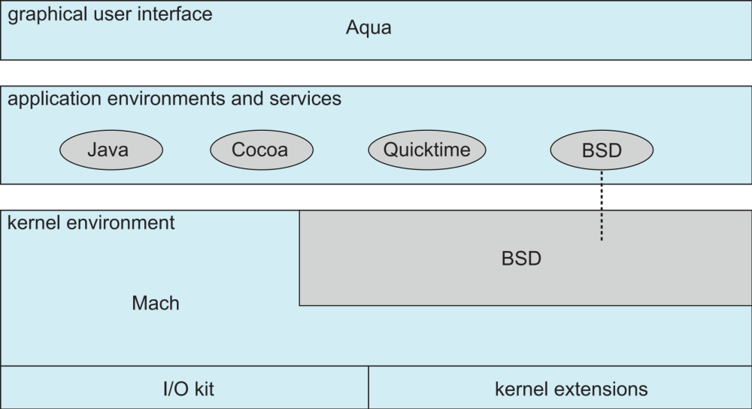
Mac OS X Structure

Slide 48
2.8 Virtual Machines
A time-sharing system 将一个CPU虚拟成多个CPU；
SPOOLing系统将一台打印机虚拟成多台打印机；
VMI (Virtual-Machine Implementation)将硬件系统(CPU、Memory、Disk driver、Network interface card， and so forth) 虚拟成多个硬件系统
每个虚拟硬件系统分别对应一个OS内核

Slide 49
Virtual Machines
A virtual machine takes the layered approach to its logical conclusion. It treats hardware and the operating system kernel as though they were all hardware
A virtual machine provides an interface identical to the underlying bare hardware
The operating system creates the illusion of multiple processes, each executing on its own processor with its own (virtual) memory

Slide 50
Virtual Machines (Cont.)
The resources of the physical computer are shared to create the virtual machines
  CPU scheduling can create the appearance that users have their own processor
  Spooling and a file system can provide virtual card readers and virtual line printers
  A normal user time-sharing terminal serves as the virtual machine operator’s console

Slide 51

Virtual Machines (Cont.)
(a) Nonvirtual machine (b) virtual machine
Non-virtual Machine
Virtual Machine

Slide 52
Virtual Machines (Cont.)
The virtual-machine concept provides complete protection of system resources since each virtual machine is isolated from all other virtual machines. This isolation, however, permits no direct sharing of resources.
A virtual-machine system is a perfect vehicle for operating-systems research and development. System development is done on the virtual machine, instead of on a physical machine and so does not disrupt normal system operation.
The virtual machine concept is difficult to implement due to the effort required to provide an exact duplicate to the underlying machine

Slide 53

VMware Architecture

Slide 54

The Java Virtual Machine

Slide 55
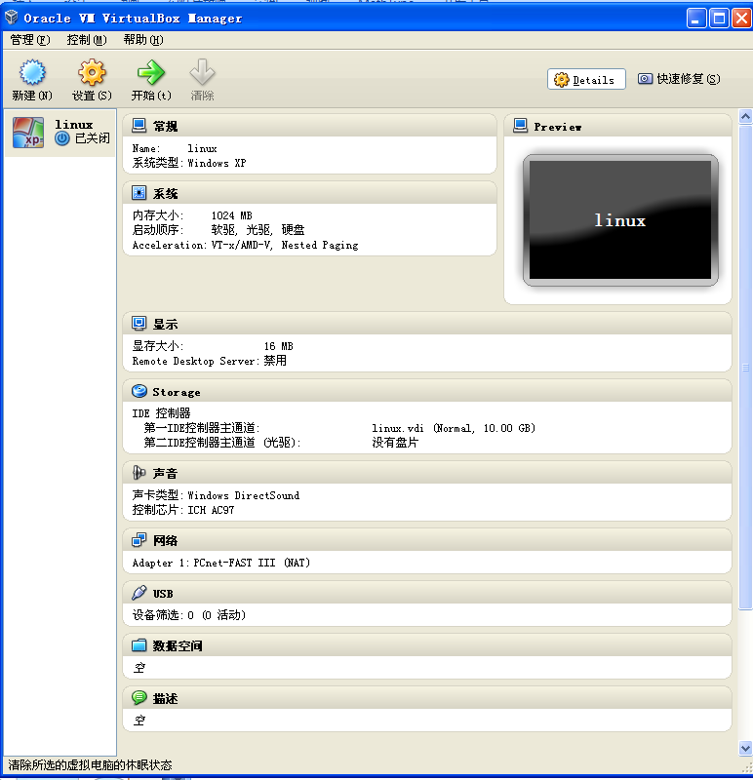
VirtualBox虚拟机

Slide 56
Windows HAL – Another meaning
Windows在硬件与内核之间设置一个硬件抽象层HAL；
HAL层屏蔽了底层的硬件特征，为内核及以上的系统提供了一个统一的接口；
使Windows可以适用于各种硬件环境；
可以这样理解：HAL将各种硬件环境抽象成一个虚拟机

Slide 57
2.9 Operating System Generation
Operating systems are designed to run on any of a class of machines; the system must be configured for each specific computer site
SYSGEN program obtains information concerning the specific configuration of the hardware system
Booting – starting a computer by loading the kernel
Bootstrap program – code stored in ROM that is able to locate the kernel, load it into memory, and start its execution

Slide 58
2.10 System Boot
Operating system must be made available to hardware so hardware can start it
  Small piece of code – bootstrap loader, locates the kernel, loads it into memory, and starts it
  Sometimes two-step process where boot block at fixed location loads bootstrap loader
  When power initialized on system, execution starts at a fixed memory location
    Firmware used to hold initial boot code

Slide 59
Homework
Two interfaces to those services for users
System call
System Call Parameters Passing
Operating System Design and Implementation
Page 73
3，6，12, 13, 14

Slide 60
End of Chapter 2

